Slide 1
Random Forest

Slide 2
Reading Assignment
Chapter 8 of the Introduction to Statistical Learning By Gareth James, et all

Slide 3
Ensemble Learning
Ensemble learning is when you take multiple machine learning algorithms and put them together to make on big machine learning algorithm
So, how it is done?

Slide 4
Ensemble Learning step by step process
Step 1: Pick a random K data points from the training set
Step 2: Build decision tree associated to these k data points
Step 3: Choose the number (N) of trees you want to build and repeat the Steps 1 and 2.
Step 4: For a new data point, make each one of your N trees to predict the category to which the data points belongs, and assign the new data point to the category that wins the majority vote.

Slide 5
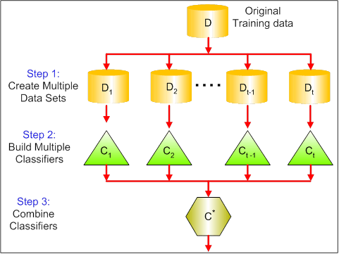
Ensemble Learning
Bagging: One of the commonly used ensemble learning techniques

Slide 6
Random Forest
So basically, Random forest is a ensemble learning model build on decision trees.
So you can build ‘N’ number of trees on a randomly selected subsets of training data.
Even though, each one of the tree might not be ideal, but overall they can perform very well. That’s the major advantage of this algorithm, instead of checking one tree, it’s checking all the trees and it takes the majority of the vote and decides classification based on that.

Slide 7
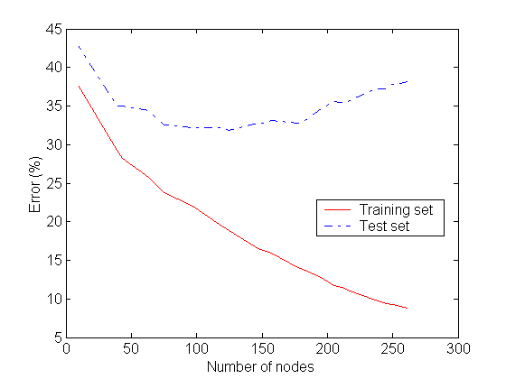
Notes:
As number of nodes increases the chances of overfitting increases in decision tree algorithm
Overfitting

Slide 8
Notes:
Classification and Regression Trees or CART for short is a term introduced by Leo Breiman to refer to Decision Tree algorithms that can be used for classification or regression predictive modeling problems
CART is a modern term for Decision Tree
R programming uses CART name
In Regression Tree, the target variable is continuous (not popular)

Slide 9
Let’s get into action with python, see you in next lecture!

